Slide 1
ONLINE EXAMNATION SYSTEM

Slide 2
AGENDA
Problem definition
Objective
Scope
Theoretical Background
Advantages of online examination system
Disadvantages of online examination system
Hardware interface
Software interface

Slide 3
Use- case diagram
E-R diagram
Screenshots
Conclusion
Future enhancement

Slide 4
Problem definition
Online Examination is very helpful to users . The aim of this project is to provide quick , immediate and easy way to appear the exam .It can provide special advantage to the student/applicants . The online examination can marks allocated in each question to determine the total marks for per question . A time limit can be set for the questions . Online examination system allow jumping to specific question based on the previous answer.

Slide 5
OBJECTIVE
Corporative between the data stored in the server of the institute and online exam system . To deal with online system in an easy way and efficient mannered.
Specify privilege for each person to allow each person use this this system to create own exam. And have complete control on his exam.
Allow each person to create more than one exam with different way to create variant question.

Slide 6
SCOPE
Online exam system is designed for Educational Institute (like school, collage, university and training center etc.)
The system handles all the operation and generates reports as soon as the test is finish.
The type of question is only multiple choice .

Slide 7
Theoretical Background
The background of system is a manual one in which users are maintaining books to store the information like Student Details , Instructor Details , Schedule Details and feedbacks about students who attempted exam as per schedule.. It is very difficult to maintain historical data.

Slide 8
Disadvantages of background study
The following drawbacks of background system emphasize the need for computerization:
A lot of copies of question papers have to be made
A lot of correction work hence delay in giving the results
A lot of tabulation work for each subject results

Slide 9
Advantages of online examination system
Physical presence at a given location is absolutely not necessary.
No time is spent on evaluation.
Results are available instantly.
Can be easily accessed 24/7 over the open test period.
Can be timed to allow Y times to answer X number of questions.
Easy accessibility.
Available at a reduced time.
Accuracy in checking answer, calculating result.
User friendly.
Secure because of authentication.
Online exams- convinced , security and flexibility.
Exams can be assembled and previewed, edited and published instantly.

Slide 10
Disadvantages of online examination system
Question are generally objective type so no chance to get marks for writing related question.
Result can’t show pass/fail of the student it only show the no of question he/she attempted, correct answer and wrong.
It provide only multiple choices but single correct answer selection.
Incase question and answer need to be in graphics, current system has no provision.
Unregistered user can only access the home page ,contact and about page.
Student only can him/her result by login . Top score are not displayed.
If internet connection is slow it create problem.

Slide 11
Hardware interface
Screen resolution of at least 800X600 is required for proper and complete viewing of screens. Higher resolution will be accepted.
Intel 3.0 Ghz or higher processor.
2 GB RAM
10 GB HDD space

Slide 12
Software interface
Any windows based operating system.
MySql Server Database
HTML and CSS
Php and javascript
AJAX
NetBeans / FrontPage / NotePad
XAMPP SERVER

Slide 13
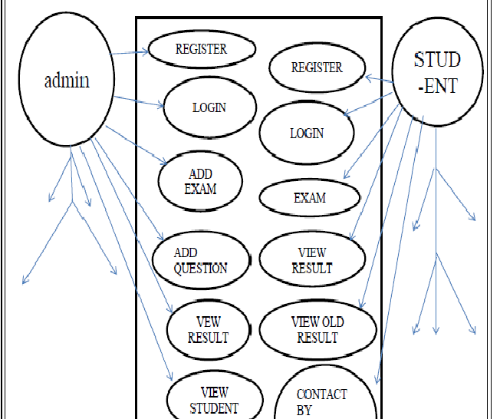
Use-case diagram

Slide 14
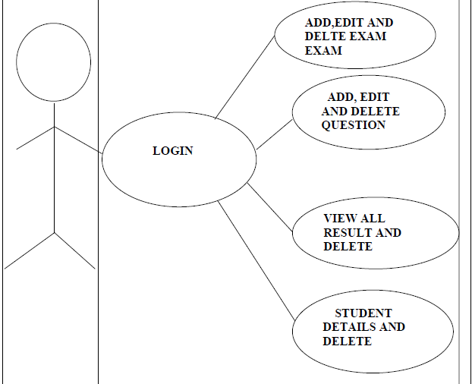
Admin side

Slide 15
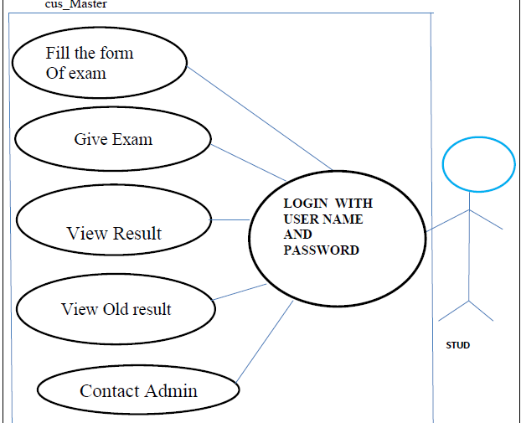
User side

Slide 16
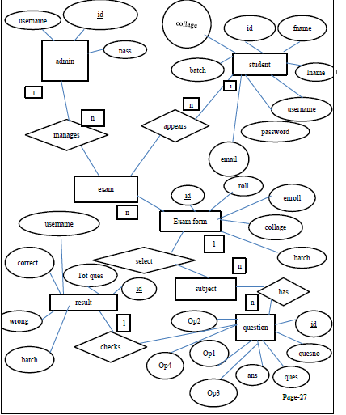
ER- diagram

Slide 17
SCEENSHOTS

Slide 18

Home screen

Slide 19
Register page

Slide 20
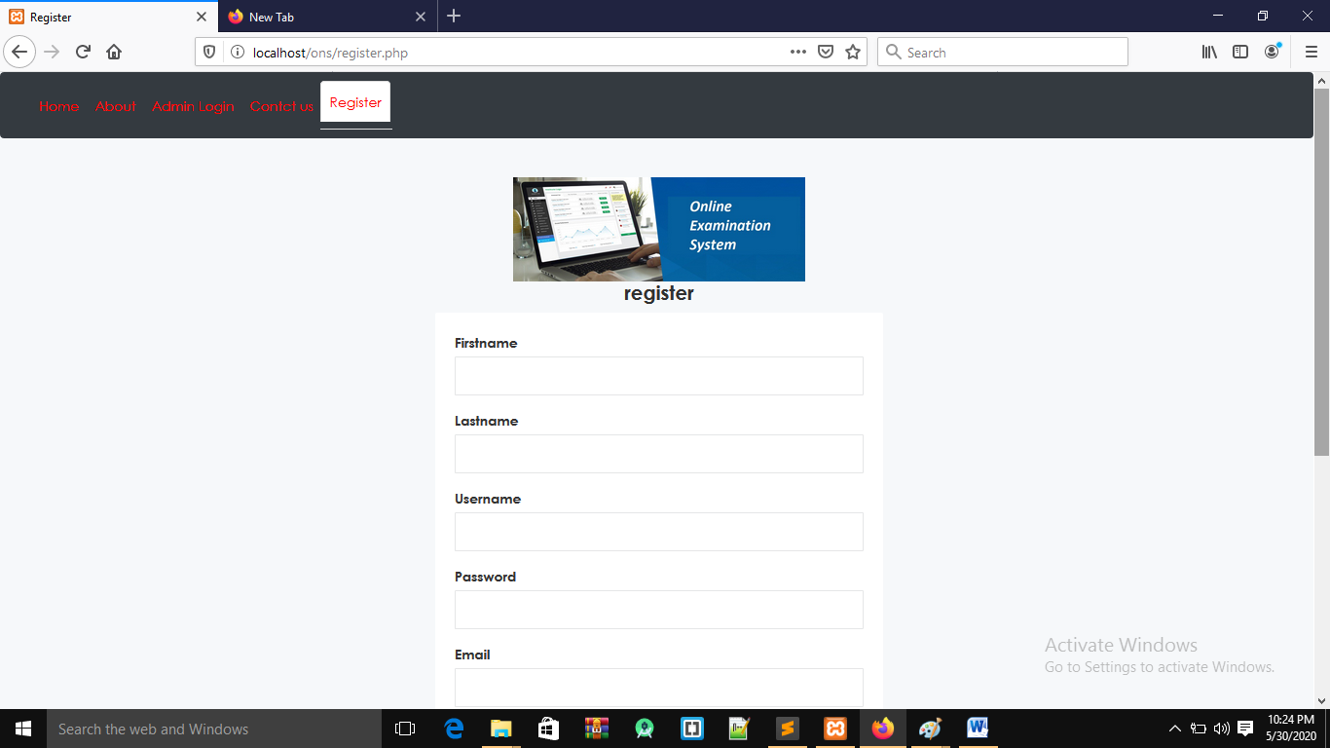

Slide 21
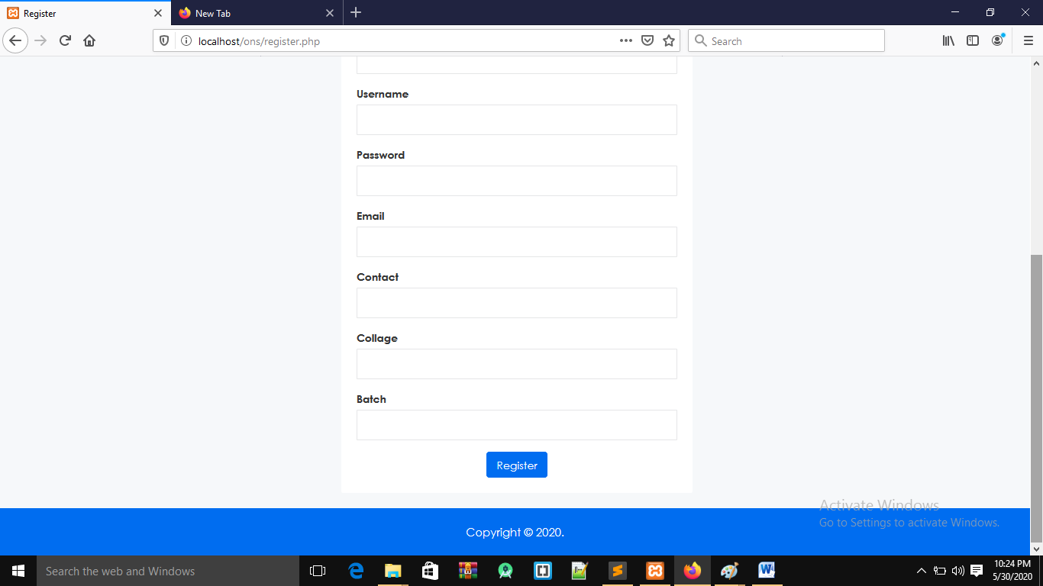

Slide 22
Admin side

Slide 23
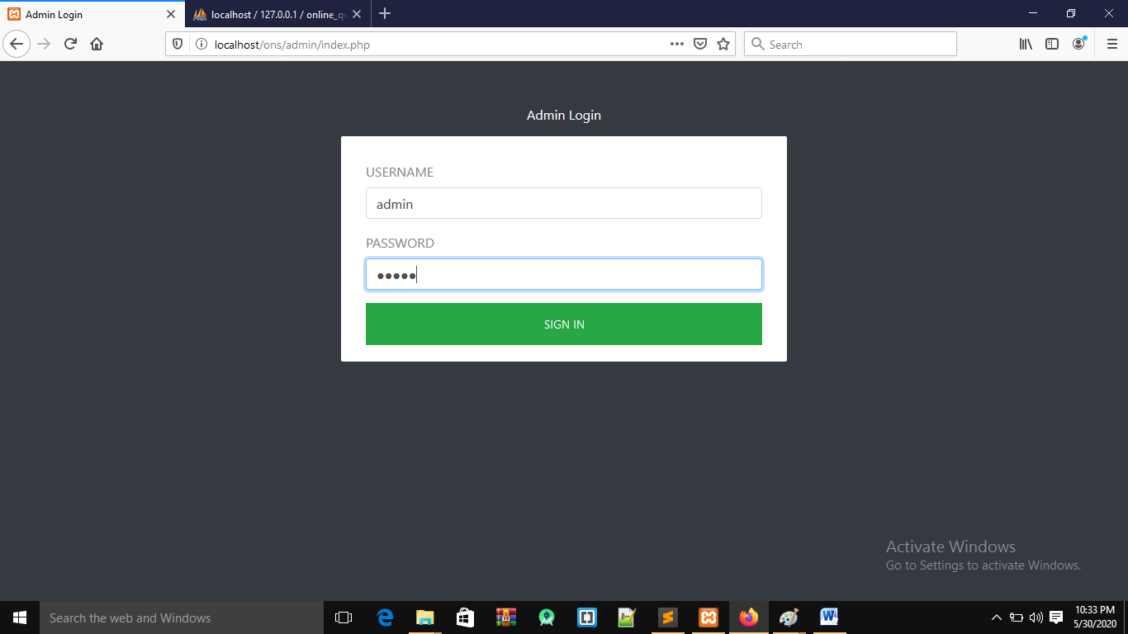
Admin login page

Slide 24
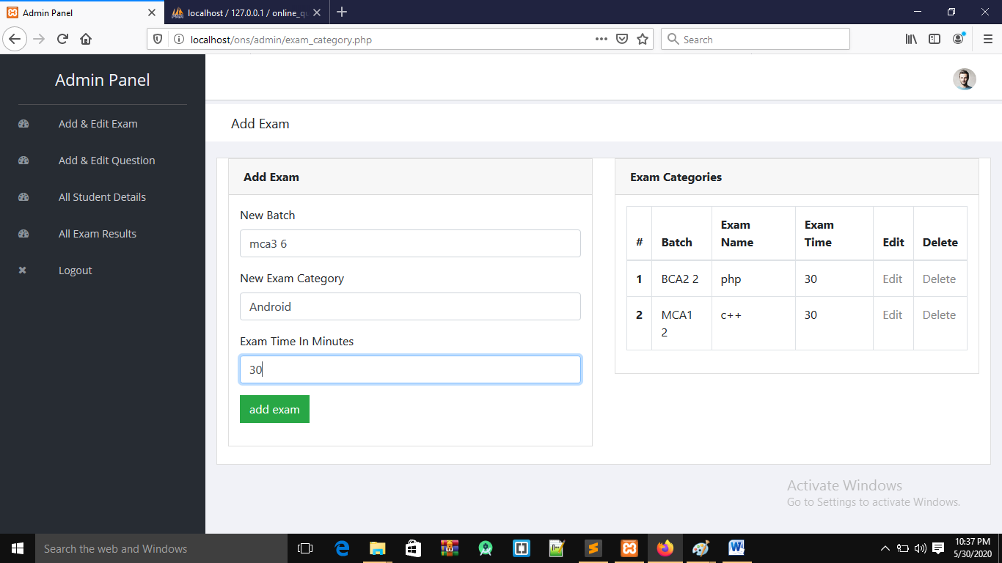
Add Exam

Slide 25
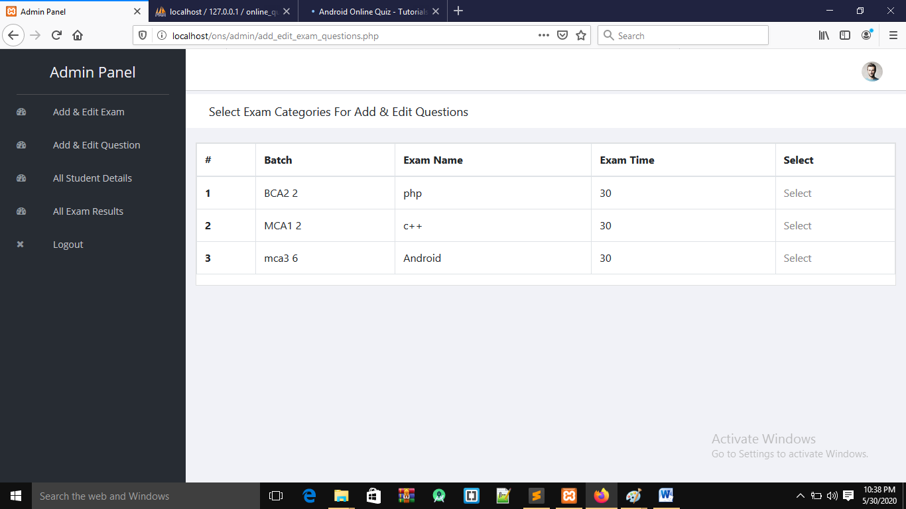
Select Exam page

Slide 26
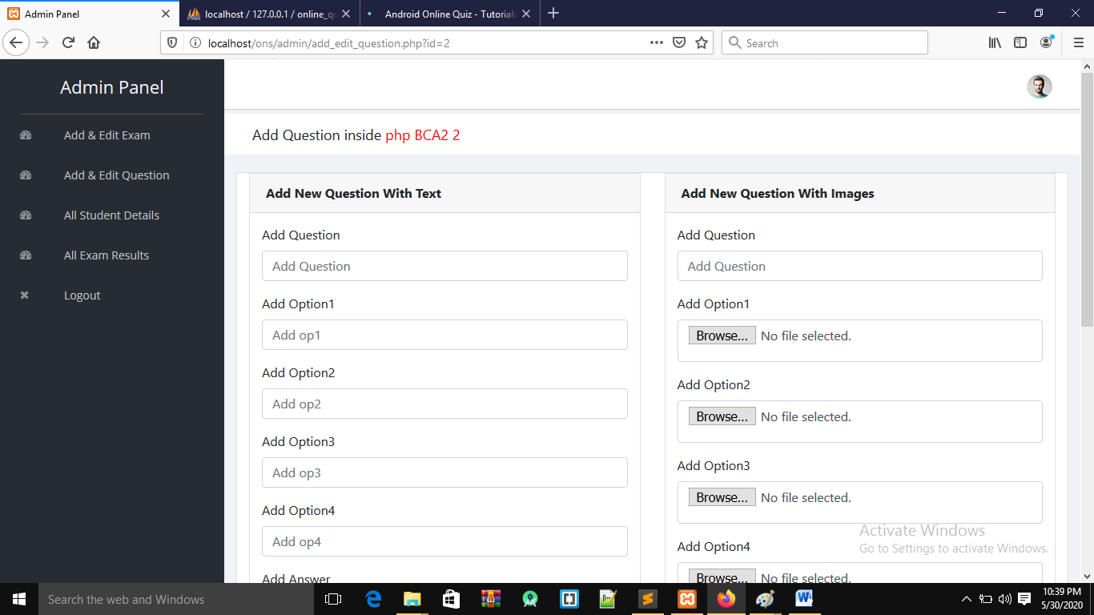
Add question page

Slide 27
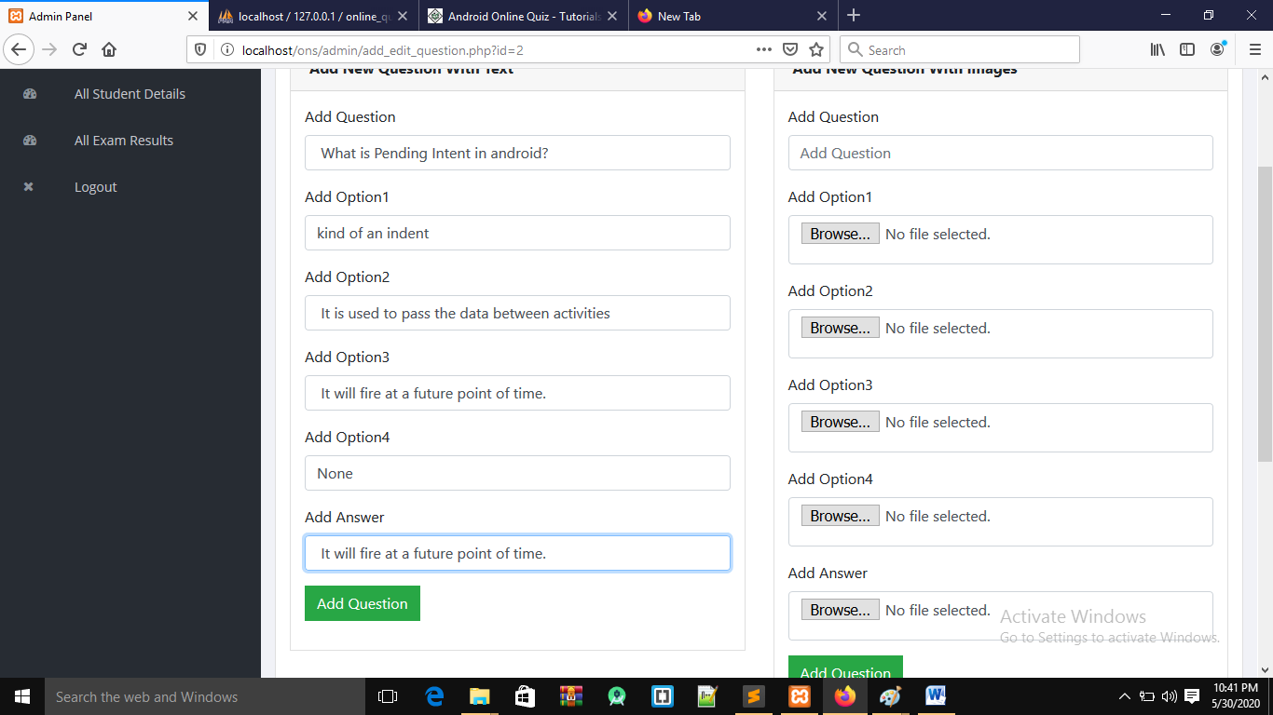

Slide 28
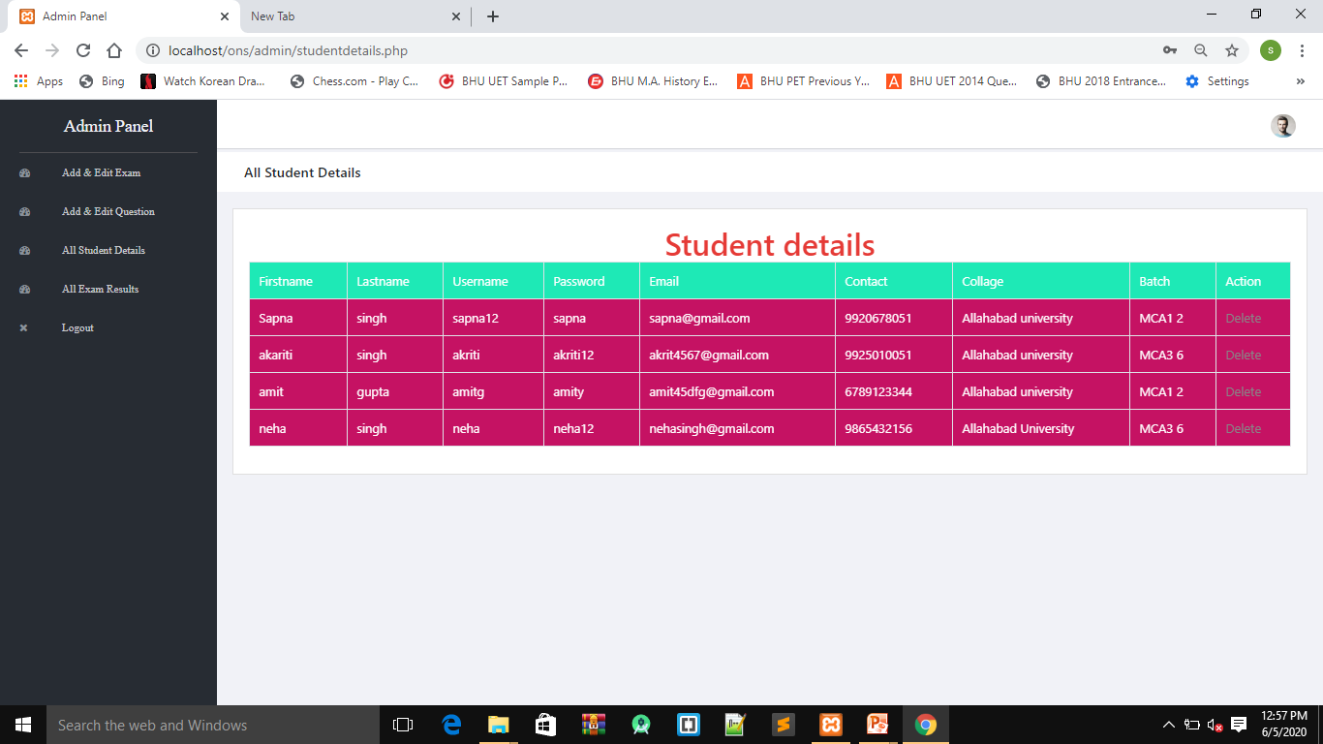
Student details page

Slide 29
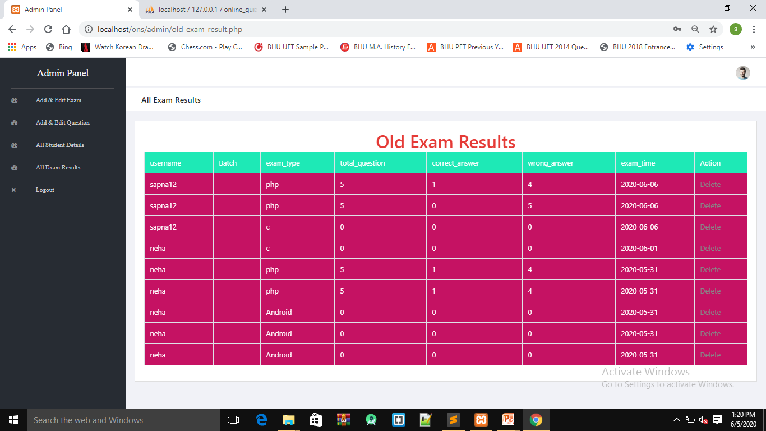
Result page

Slide 30
User side

Slide 31
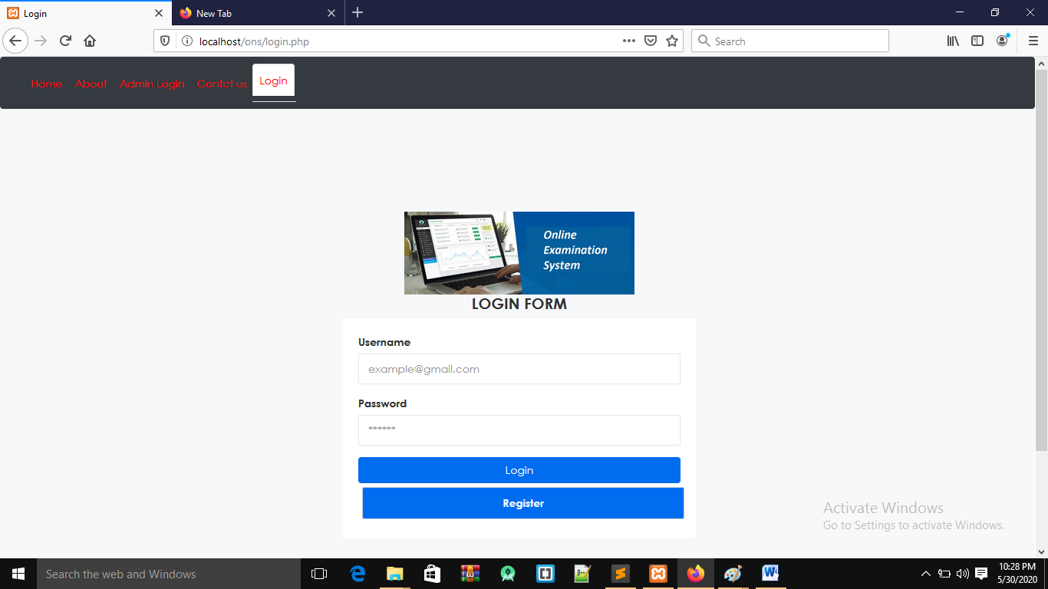
Login page

Slide 32
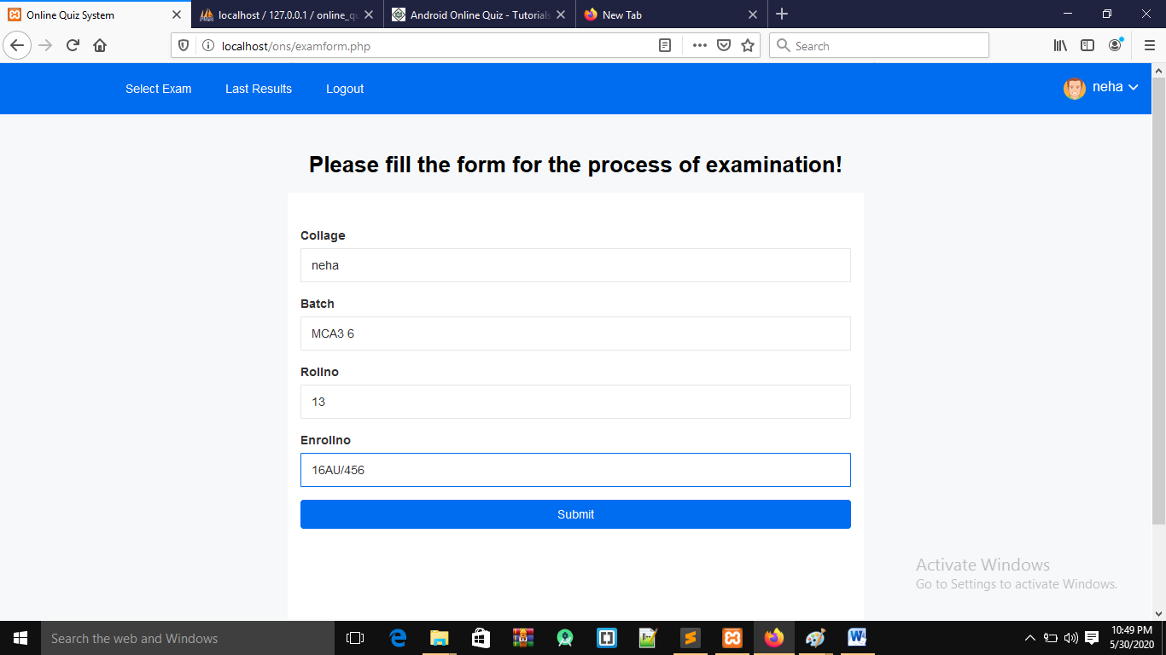
Exam form page

Slide 33
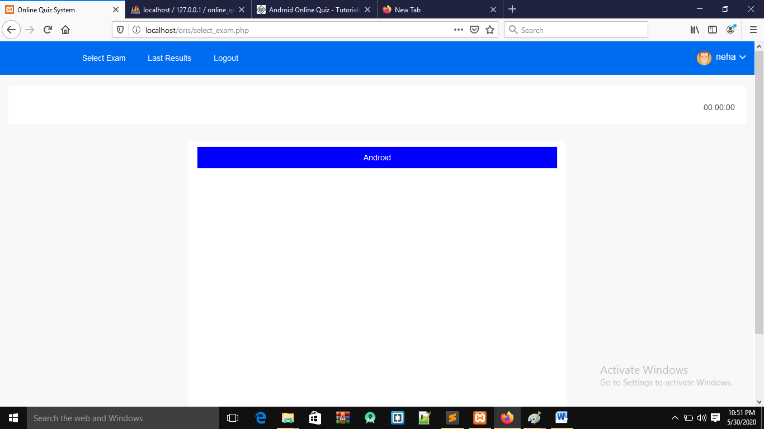
Select exam

Slide 34
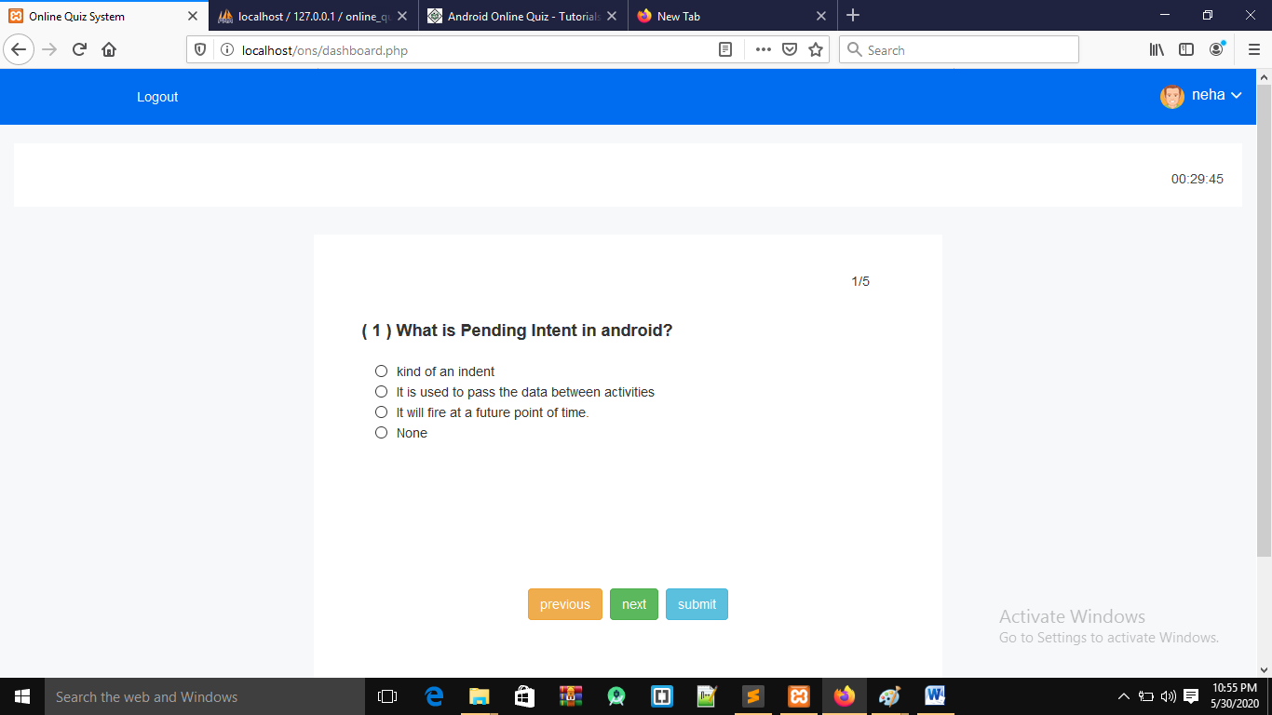
exam

Slide 35
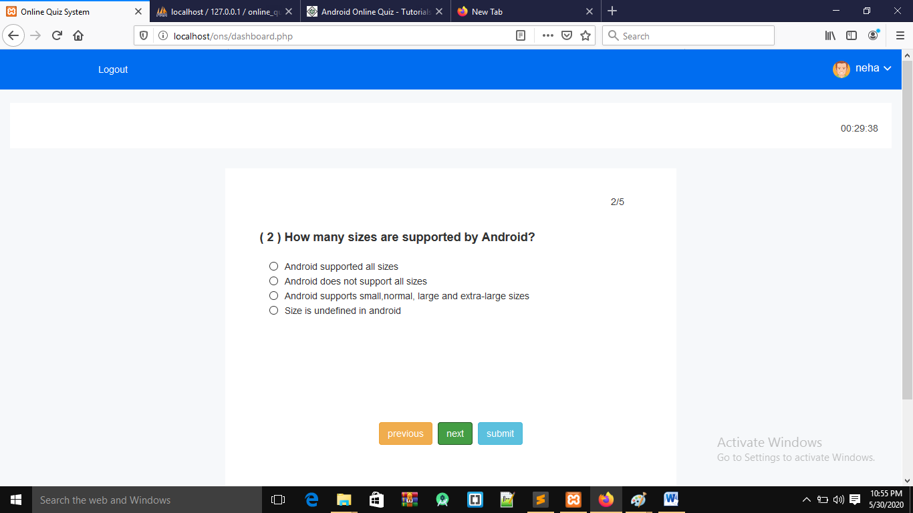

Slide 36
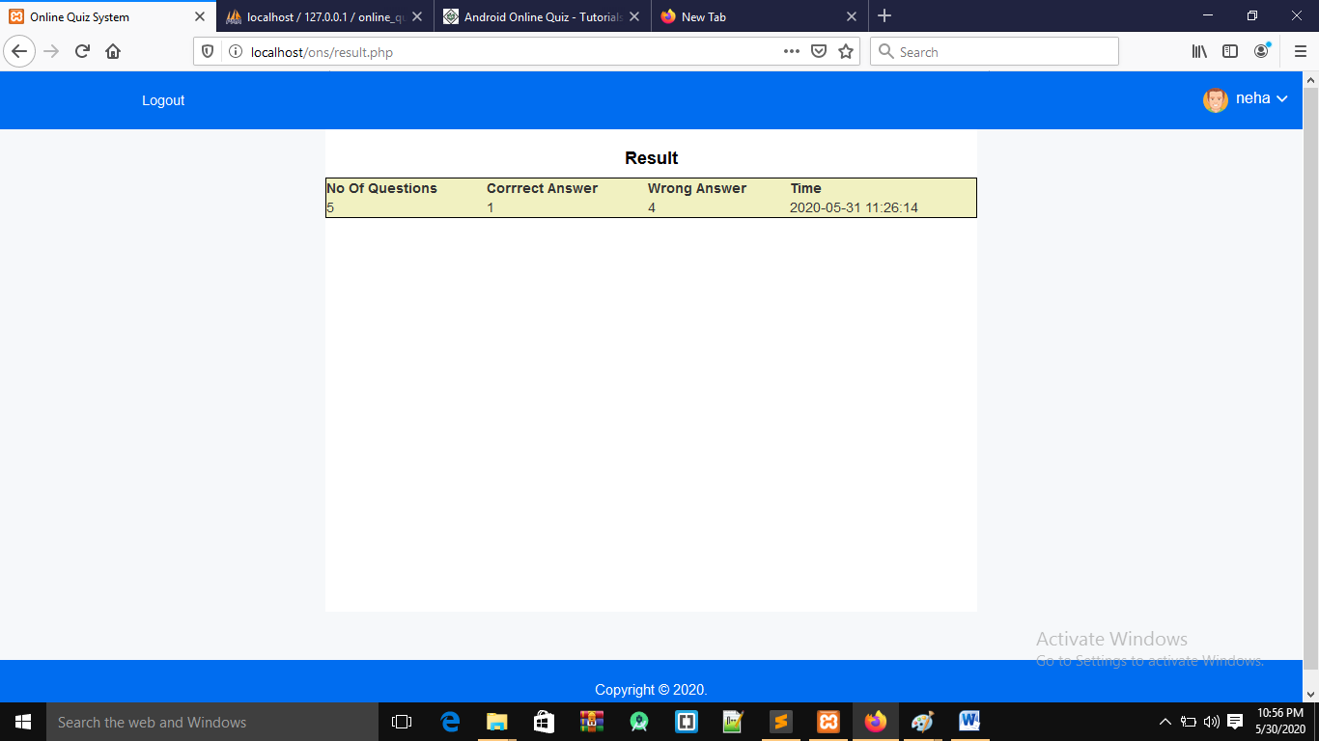
Result page

Slide 37
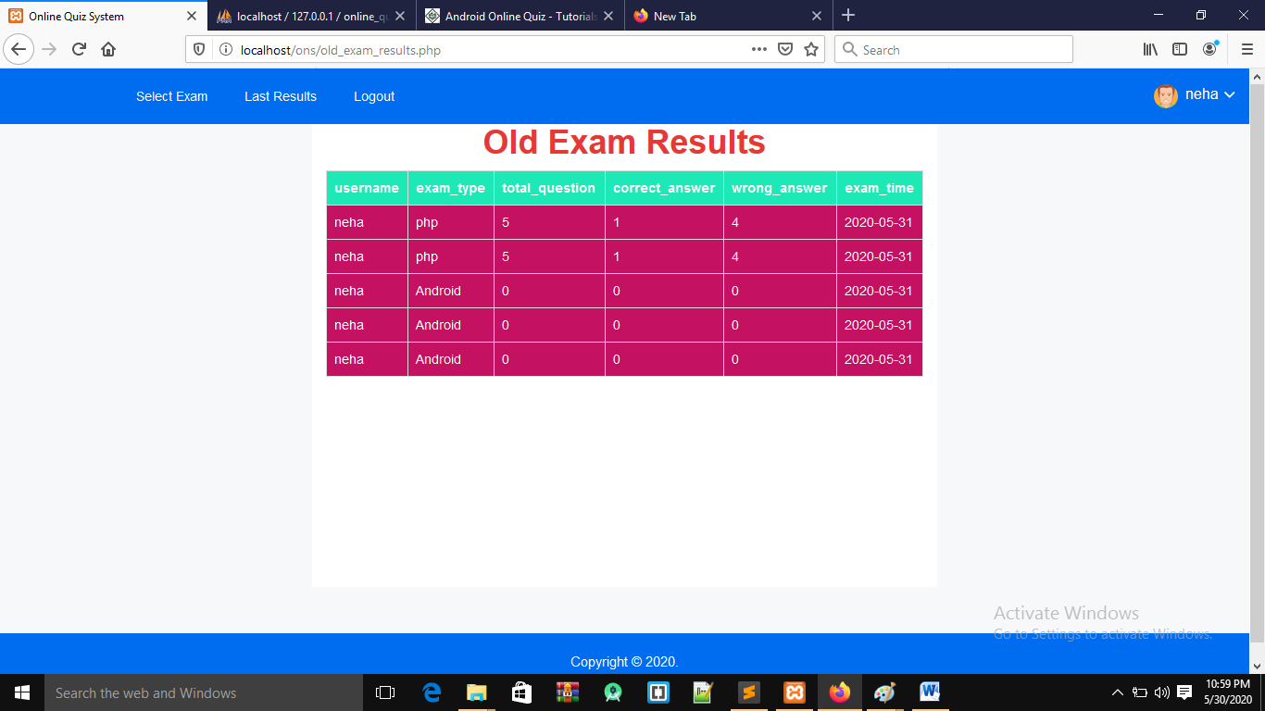
Old result page

Slide 38
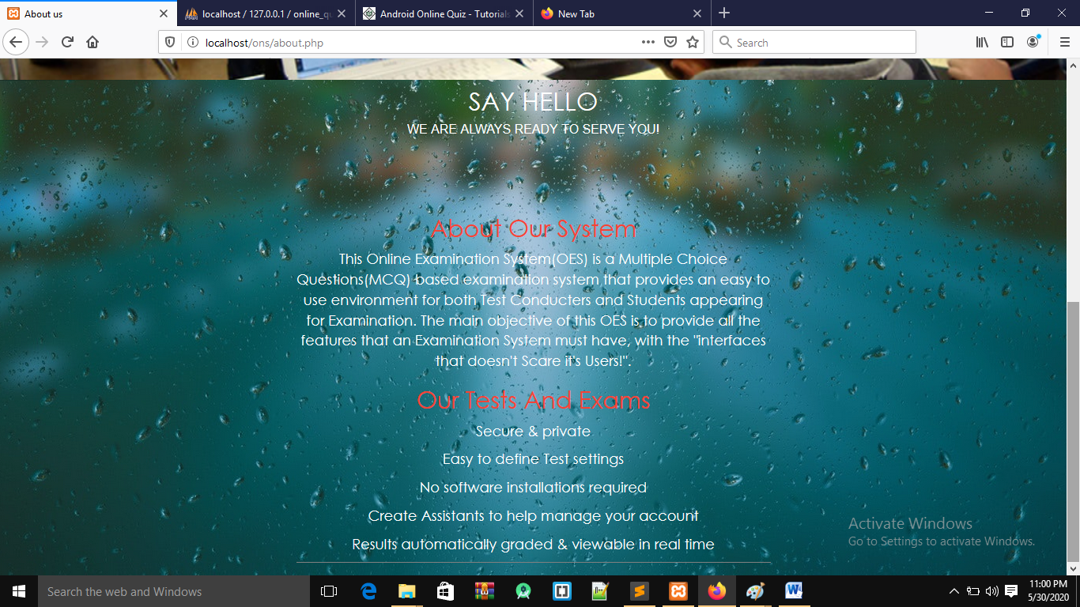
About us page

Slide 39
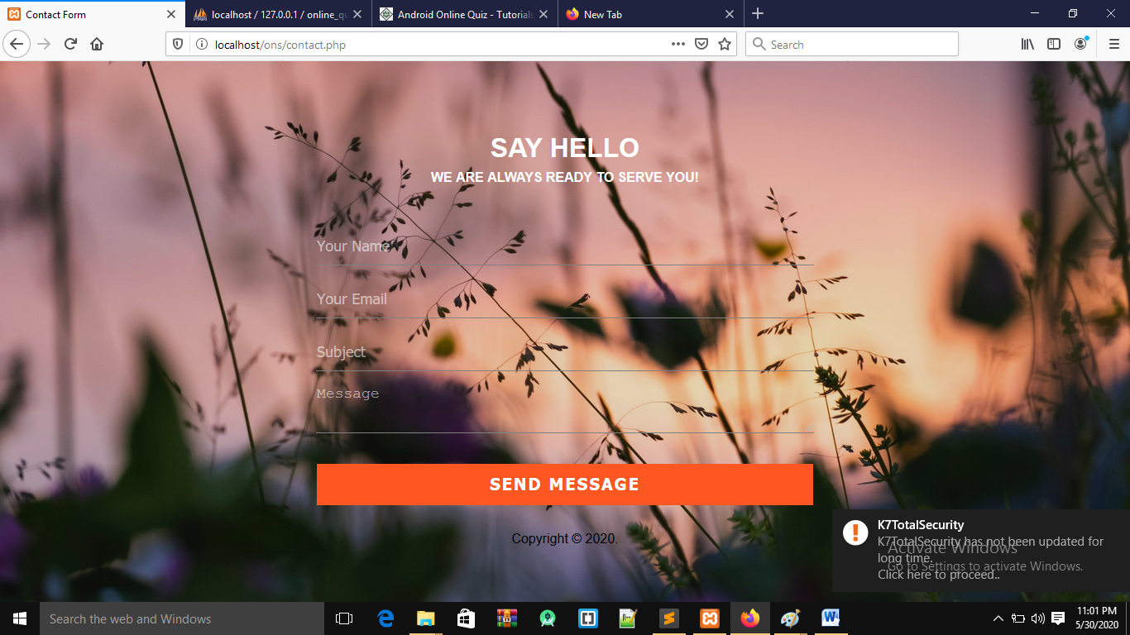
Contact us page

Slide 40
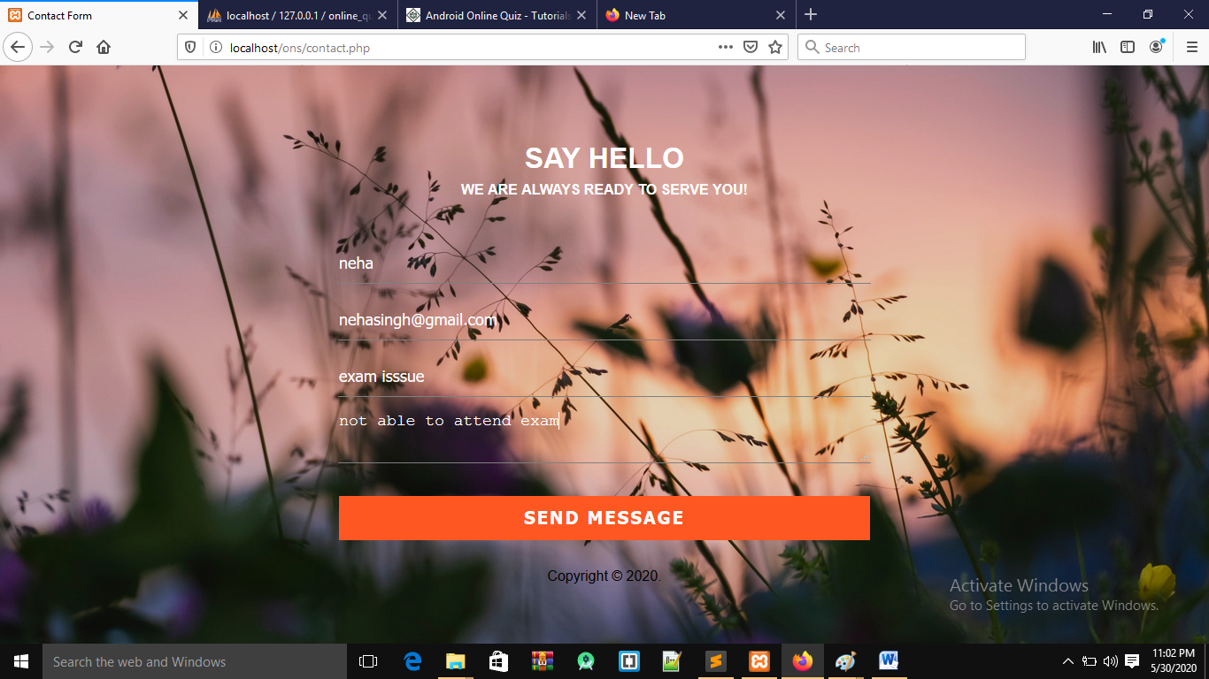

Slide 41
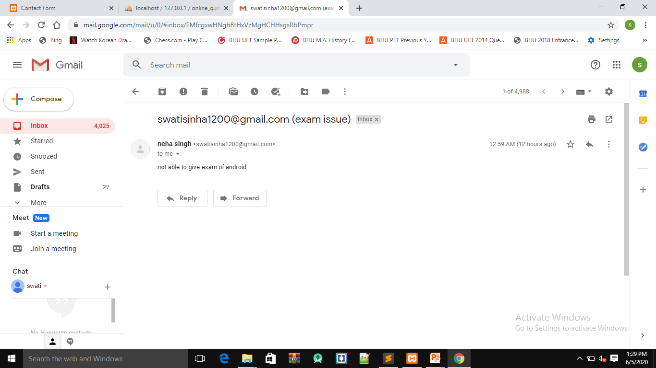
gmail

Slide 42
conclusion
The package was designed in such a way that future modifications can be done easily. The following conclusions can be deduced from the development of the project.
Automation of the entire system improves the efficiency
It provides a friendly graphical user interface which proves to be better when compared to the existing system.
It gives appropriate access to the authorized users depending on their permissions.
It effectively overcomes the delay in communications.
Updating of information becomes so easier.
System security, data security and reliability are the striking features.
The System has adequate scope for modification in future if it is necessary.

Slide 43
Future enhancement
Every Application has its own merits and demerits .The project have covered almost be done since the coding is mainly structured and modular in nature. Changing the existing modules or adding new modules can append improvement . This computerized method is a well-suited application for real time. Well I have worked hard in order to present an improved website better than the existing one’s regarding the information about the various activities. Still ,we found out that the project can be done in a better way. Primarily, when we request information about a particular schedules it just shows the exam and result. And user can access online examination.

Slide 44
So according to my perspective the following module can be subjected to further enhancements:
Add multiple selecting option.
Add score of result and display ranking of student.
Add search particular student details in the site.
Developed discussion forum
Multimedia feature support
Implementation in cloud server
Record video and analyze
Faculty can generate lecture on this site and missed class can view those video
Add more browser security feature
Preview of question paper with its answer
Generate the report based of its results.

Slide 45
THANK YOU!!!

